Slide 1

Linear Search
A linear search is a sequential search.
It is a method for finding a particular value in a list that checks each element in sequence until the desired element is found or the list is exhausted.
The list need not be ordered.
Notes:
Time to learn simple algorithms! First up is Linear Search! Linear search is nothing but a sequential search for finding a particular value in a list which checks each element in the list. Let’s understand using an example to make life easier! For example-Consider, a queue of students standing randomly and you have to find one particular student.Then, you have to check the first student.If he was the desired student then stop.Otherwise move to the second student and repeat this process until you reach the end.

Slide 2
Algorithm
Linear-Search(List,value)
Set I=0(for index),found=false
Loop through each element in the list.
Check If(element==value),then set found=true and goto step 5
Else increment I and continue to next iteration
Return I(index),found
Notes:
Let’s look at it’s algorithm now!
We make a method Linear-Search whose arguments will be the list in which we want to find the element and value would be the number which we want to search in the list.
Firstly we take I variable as index of the list and found variable which will store true when the element is found else will store false. The default value of found is false. Now we iterate through the list, scanning each element, comparing each element to the value that we pass in the method (the value we want to find), then if element and value are equal then found is set to true and we exit the loop and return index i.e I and value of found, otherwise we increment I and continue to the next iteration. Now if the value that we want to search in the list is not present in the list then value of I is returned which is one greater than last index of the list and found is returned false.

Slide 3
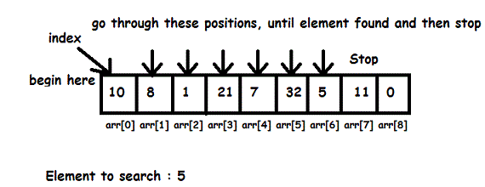
Example
In the above example.We will first set I =0 and found to false. Then we will compare it with each element until we reach the end.If we find our desired element in between then we will stop set found=true and return the value of I and found.In this case, we will return (6,True).That means the element is found at 6th index.
Notes:
We can understand it even better! Here, We will first set I=0 and found to false .Then we will compare it with each element until we reach the end.First we will compare it with element stored at index=0 i.e 10 and that doesn’t match 5 so we move on to next element i.e 8 and compare it with 5 this goes on till last element, if we find our desired element in between then we will stop set found=true and return the value of I and found.In this case, we will return (6,True).That means the element is found at 6th index. Isn’t that easy!

Slide 4
Implementation
def linear_search(sequence,value):
i=0
found=False
for item in sequence:
if(item==value):
found=True
break;
i=i+1
return i,found
print (linear_search([1,3,5,'python',7],'python'))
print (linear_search([1,3,5,'python',7],11))
Output:
(3, True)
(5, False)
Notes:
Time to implement linear search! By now you must have understood what it is all about! You must go through this code once for better understanding and solidifying the concept. Here linear_search method is called twice on the same list [1,3,5,'python',7], but in first call we search ‘python’ in the list then we search 11 in the list in second call.

Slide 5

Binary Search
Binary search is also known as half-interval search.
It works by comparing the target value to the middle element of the array; if they are not equal, the lower or upper half of the array is eliminated depending on the result and the search is repeated until the position of the target value is found.
Notes:
Now let’s study Binary Search! Don’t worry I will make it easy for you! Its also known as half-interval search. Let’s understand this by an example! Consider an Oxford dictionary. How do we search a word in it? We first split the dictionary in half and then check if our word lies in the first half or second half. If it lies in the first half. Then we select the first half and split it again. Perform the same procedure until we reach our desired result. The main thing to keep in mind is that at each step we are getting rid of half of the initial data, whereas in linear search we were getting rid of a single element.

Slide 6
Algorithm
Binary-Search(SortedList,value,size)
1.Set start=0,end=size-1,found=false
2.while start<=end,repeat step 3,4,5
3.mid=(start+end)/2
4.if (value==List[mid]),then set found=true and goto step 7
5.elif (value>List[mid]),then set start=mid+1
6.else,then set end=mid-1
7.return mid,found
Notes:
Let’s look at it’s algorithm now!
We make a method Binary-Search whose arguments will be the list in which we want to find the element (it must be sorted), the value would be the number which we want to search in the list and size would be the size of the Sorted List.
Firstly set start=0, end=size-1 (i.e the last index of the list) and found variable whose default value is false but when we find the value it's set to true.
Then run a while loop till variable start is less than equal to end variable and in that loop set variable mid equal to the sum of start and end divide by 2(truncated value). Now if value of the element need to be searched is already at mid value of the list then exit the loop and set found equal to true else go to next step i.e if value is greater than mid of the list then we will drop the first half of the list and set start equal to mid plus 1 else drop the last half of the list and set end equal to mid minus 1. This is done, till variable start is less than equal to variable end, when variable start becomes greater it means that list has finished and the element we wanted to search in the list is not present in the list. At last, we return the value of variable mid i.e the value of the index where we find the value and variable found which will be true or false.

Slide 7
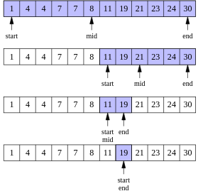
Example
Searching 19
Initially,set start=0, end=11 ,found=false
Loop 1:
mid=(0+11)/2=5(truncated).Since, 19>8 set start=5+1=6.
Loop 2:
mid=(6+11)/2=8.Since, 19<21 set end=8-1=7.
Loop 3:
mid=(6+7)/2=6.Since, 19>11 set start=6+1=7.
Loop 4:
mid=(7+7)/2=7.Since 19=19 set found=true and Return mid,found//Output:(7,True)
Notes:
Let’s try to understand it, here let’s consider the list shown in the image and we want to search 19 in it.
Initially,set start=0, end=11 i.e to the last index of the list ,found=false In Loop 1: mid=(0+11)/2=5(truncated).Since, 19>8 drop the first half. set start=5+1=6. In Loop 2: mid=(6+11)/2=8.Since, 19<21 drop the last half. set end=8-1=7. In Loop 3: mid=(6+7)/2=6.Since, 19>11 drop the first half, set start=6+1=7. In Loop 4: mid=(7+7)/2=7.Since 19=19 set found=true and Return mid,found Wasn’t that easy!

Slide 8
Implementation
def binary_search(sequence,value,size):
start=0
end=size-1
found=False
while(start<=end):
mid=(start+end)//2 # Decimal gets truncated
print (sequence[mid])
if(value==sequence[mid]):
found=True
break
elif(value>sequence[mid]):
start=mid+1
else:
end=mid-1;
return mid,found
print (binary_search([1,2,6,7,16,36,53,66,74,77],7,10))
print (binary_search([1,2,6,7,16,36,53,66,74,77],55,10))
Output:
(3, True) (6, False)
Notes:
Here comes how to implement binary search!
Here we call binary_search twice on the same list.
On first call we search 7 which is present at index=3 in the list.
On second call we search 55 which is not present in the list.

Slide 9
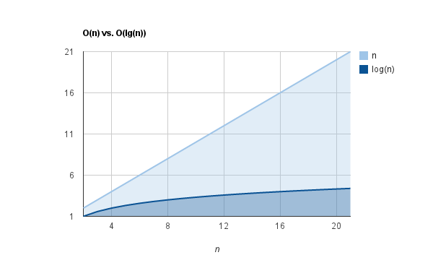
Comparison Between linear and binary search
We need sorted list in binary search whereas we can use any kind of list for linear search.
Complexity:Linear Search=O(n),Binary Search=O(log n).
Notes:
As explained in the last tutorial that explained order of growth, why not compare binary and linear search!
Complexity of binary search is O(logn) and is more efficient than linear search that has complexity of O(n).
The main drawback of binary search is that the list need to be sorted.

Slide 10

When to Use linear search and binary search
1. If we can’t sort list in any way, then we use linear search.
2. It’s a thumb rule to use binary search whenever list is sorted.
Notes:
Now at this point you must be wondering, when to use them? They do the same work i.e to find an element in a given list that we want.
We can use binary search only when the list is sorted, that’s the main point to be noted. If we can’t sort list in any way then we will use linear search.
I think now you can decide! Good to go!

Slide 11

Quiz
Write a program to find the time taken by linear search and binary search to find 99999 in a list of 1-100000 numbers in ascending order?
Notes:
Congrats! You are just one step away from completing simple algorithms! Check this quiz out! Then you can decide whether concepts are clear or not!

